Slide 1

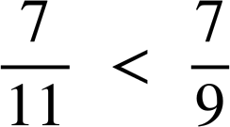
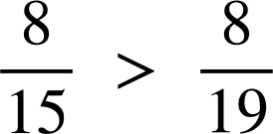
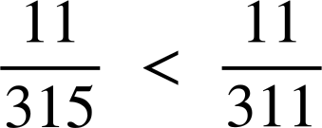
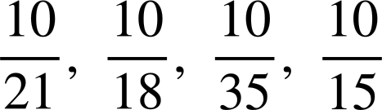
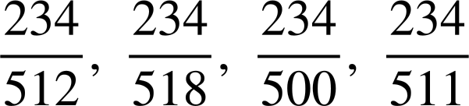



Ordering fractions in different ways
Task A: Comparing fractions using a common numerator
1) Insert either < or > to make the statement true.
a)
c)
b)
d)
e) Place the words ‘larger’ and ‘smaller’ in the sentence:
The the denominator the the ‘parts’.
2) Write the following in order from smallest to largest.
a)
b)
3a) Place the words ‘larger’ and ‘smaller’ in the sentence:
is than but than .
Jacob says ‘ is exactly halfway between and . ’
Is he correct?
c) Find another fraction between and .
Find a fraction that is closer to .
Find the fraction that is exactly halfway between and .

Slide 2
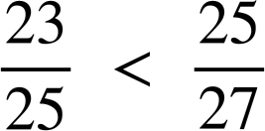
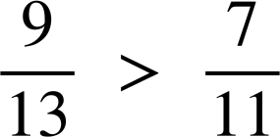
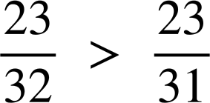
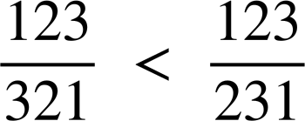
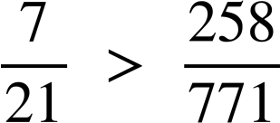
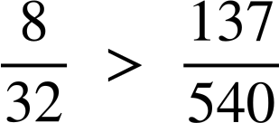
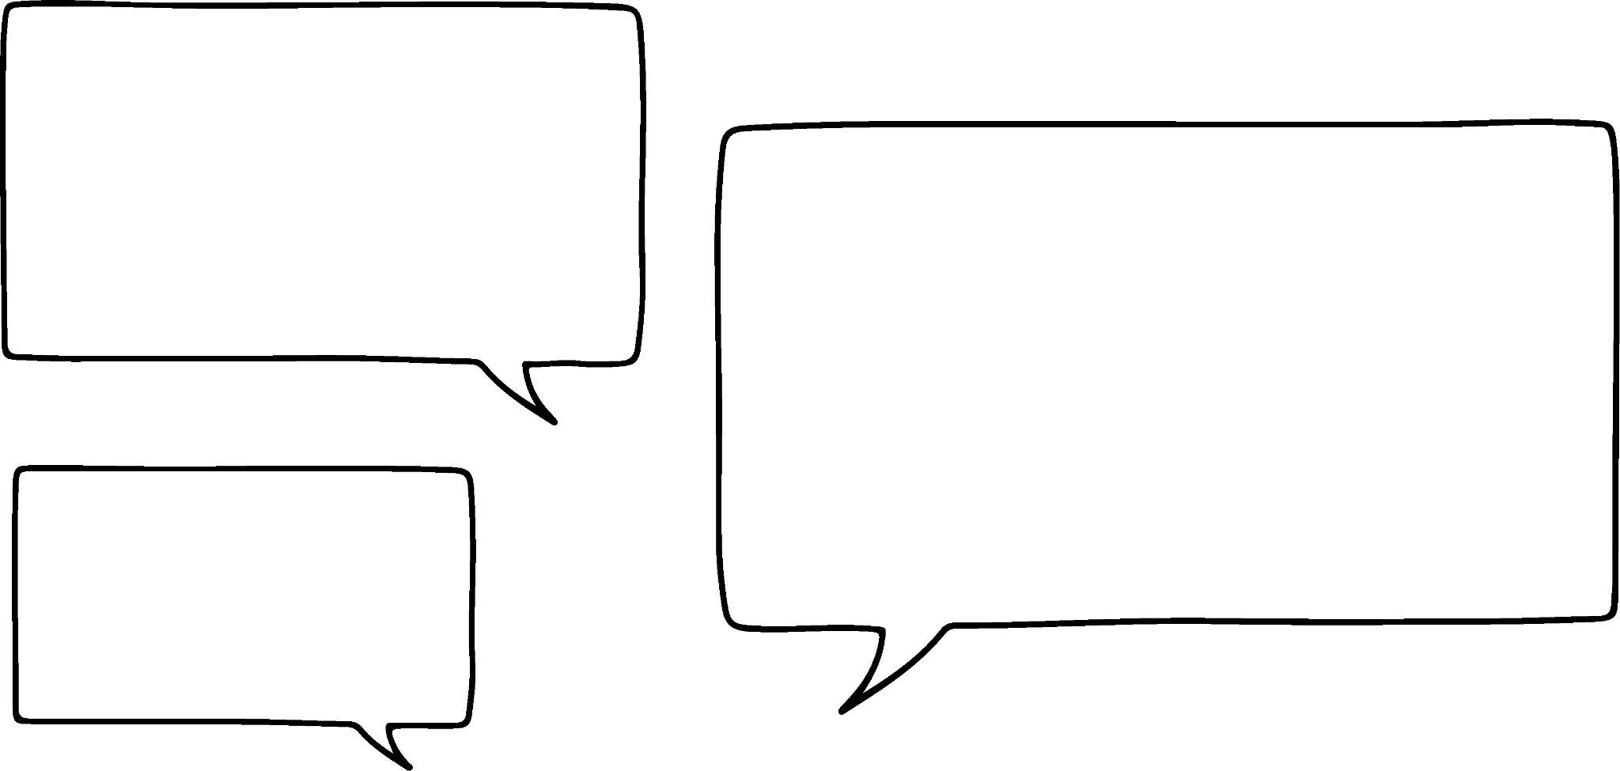



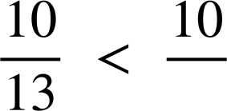
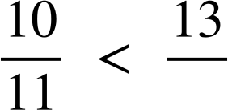
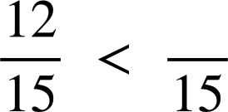
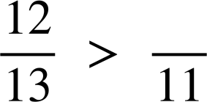
Ordering fractions in different ways
Task B: Ordering by comparing to one
1) Choose the most appropriate method to decide which of the following statements are true.
a)
d)
b)
e)
c)
f)
2) Explain why Aisha is wrong.
is larger than
Aisha
3) Use these numbers to complete the following proper fractions. 10, 11, 12, 13, 14 and 15.
The fraction closest to one
The fraction closest to zero
e)
d)
f)
Mathematics in Education and Industry
v2.1

